Slide 1
Weightless Neural Networks for Depth Map Estimation
Helio Perroni Filho
Doctorate Program in Computer Science, 1st Year
Graduate School of Systems and Information Engineering
Notes:
Good evening everyone, I am Helio Perroni Filho and I'm here to report my research on Weightless Neural Networks for Depth Map Estimation.

Slide 2
Profile
2004: Bachelor in Computer Science, UFES
2004: Software developer at Mogai
2006: Computer vision project for Aracruz Celulose
2008: Software Engineer at LG Electronics
2010: Master in Computer Intelligence, UFES
2013 (Apr): Admitted to Brazilian scholarship program “Ciencia sem Fonteiras” (“Science without Borders”)
2013 (Oct): Started PhD course, University of Tsukuba
Present: Working on thesis project, applications of Weightless Neural Networks to robot localization problems
Notes:
First a little about me.
In 2004 I graduated from the Computer Science course of the Federal University of Espirito Santo, in Brazil. At that year I was also contracted as full-time software developer by Mogai Tecnologia de Informacao, which did software development work for large industries in the Vale do Rio Doce region.
In 2006 I had my first contact with computer vision, in an automation project for paper company Aracruz Celulose. The project failed, but partly because of it in 2007 I went back to UFES for a Master course on Computer Intelligence. I completed the course in 2010; by that time I had already moved on to LG Electronics, where I worked at the mobile software development division.
In 2013 I was admitted to the Brazilian government's “Science without Borders” program, which allowed me to start my doctorate course at the Robotics Laboratory here in Tsukuba, this last October.
Currently I am working under Prof. Ohya in applying Weightless Neuron Networks to problems of environment recognition and localization for mobile robots.

Slide 3
Introduction
Weightless Neural Networks (WNN's)
Depth Map Estimation
Visual Representations for WNN's
WNN Architecture
Results
Doctoral Research
Notes:
This presentation is divided as follows.
First I present a primer on Weightless Neural Networks.
Then I describe the problem of Depth Map Estimation.
Next I show one way to represent visual information in Weightless Neural Networks.
I show the WNN architecture I developed to try and solve the depth map estimation problem.
I report what were the results I achieved.
And last I briefly discuss the work I'm currently developing at the robotics lab.

Slide 4
Weightless Neural Networks
A Weightless Neuron stores (Input, Output) pairs
Inputs are bit strings of a fixed length r
Outputs are elements from a discrete image set Y
R
I (r = 3)
O
b1
1
1
0
y1
b2
0
0
1
y2
b3
0
1
0
y3
Notes:
Let's start from the basics. A single weightless neuron (not yet a network, just one separate neuron) stores a list of inputs and associated outputs.
Outputs can be just about anything: there is no restriction on the properties of the output set. But inputs must be bit strings, that is, sequences of values zero and one. Each weightless neuron is restricted to storing bit strings of a fixed length r; in this example, r is 3.

Slide 5
Weightless Neural Networks
A neuron is trained by writing (bk, yk) pairs to its memory
R
I (r = 3)
O
(b1, y1)
b1
1
1
0
y1
(b2, y2)
b2
0
0
1
y2
(b3, y3)
b3
0
1
0
y3
Notes:
A weightless neuron is “trained” simply by writing entries to its input and output lists. So in this example, if we have three cases we want the neuron to learn, we just append them to the input and output list one after the other.

Slide 6
Weightless Neural Networks
A trained neuron can be queried with a bit string bx
Querying finds the bit string bk that is closest to bx
The value associated to bk is the query's response
R
I (r = 3)
O
b1
1
1
0
y1
bx
1
0
1
y2
d(bx, b1) = 2
b2
0
0
1
y2
d(bx, b2) = 1
b3
0
1
0
y3
d(bx, b3) = 3
Notes:
Recovering information from a neuron is likewise simple. When a weightless neuron is queried with a bit string “b x” not in its input list, it looks for the known input that is closest to this unknown query input, and returns its associated output as response. Here “closer” is defined in terms of the number of flipped bits between strings, also known as the “Hamming distance”.
In our working example, query bit string “b x” is compared to bit strings “b 1”, “b 2” and “b 3”, yielding the distances 2, 1 and 3 respectively. So the output “y 2” associated to input “b 2”, which had the smallest distance from “b x”, is returned.

Slide 7
Weightless Neural Networks
Unknown function f : X → Y
Sets X, Y are discrete, elements may not be numerical
A training set of (xi, yi) pairings is available
Example: X = {animal descriptions} , Y = {animal categories}
X = {xi = (Legs, Cover, Habitat)}
4 | Hair | Ground
0 | Scales | Water
6 | Chitin | Ground
Y = {yi = (Name)}
Mammal
Fish
Insect
6 | Chitin | Water
?
Notes:
What is a weightless neuron useful for?
Imagine we have an unknown function “f” we want to approximate. The domain and image sets of “f” are discrete, and may not even be numerical. The good news is that we have a set of example inputs and outputs for “f”, from which we hopefully can deduce something useful about how “f” works.
Let's take an example. Imagine we have a domain set X of animal descriptions, and an image set Y of animal categories. As you can see each entry in the set X is formed by three properties: the animal's number of legs, his body cover, and whether it lives on ground or water. Each entry in set Y is the corresponding animal category.
How could we approximate a function “f” mapping elements between these sets X and Y, so we could estimate the category for an animal description not in the training set?
Let's see how we could do it with with a weightless neuron.

Slide 8
Weightless Neural Networks
Design a mapping function λ : X→B ^{r} , B = {0, 1}
X = {xi = (Legs, Cover, Habitat)}
4 | Hair | Ground
0 | Scales | Water
6 | Chitin | Ground
B ³
0 | 0 | 1
0 | 0 | 0
1 | 1 | 1
λ
Notes:
First off, the elements from set X obviously aren't bit strings, so we need some way to map them to bit strings before we can train a weightless neuron.
We define our function lambda, that takes an element from X as input and returns a bit string of length 3, as such:
The first bit in the string is 1 if the animal has more than 4 legs, and 0 otherwise.
The second bit is 1 if the animal is covered in chitin, and 0 otherwise.
The third bit is one if the animal lives on ground, and 0 otherwise.
Given this function, we can now convert the entries from domain set X to bit strings.

Slide 9
Weightless Neural Networks
Write the (λ(xi), yi) pairs to a neuron's memory
R
I (r = 3)
O
(λ(4, Hair, Ground), Mammal)
b1
0
0
1
“Mammal”
(λ(0, Scales, Water), Fish)
b2
0
0
0
“Fish”
(λ(6, Chitin, Ground),Insect)
b3
1
1
1
“Insect”
Notes:
We can now create a training set where the inputs are bit strings representing entries from set X, and outputs ate the corresponding entries from Y. Then we use this set to train a weightless neuron.

Slide 10
Weightless Neural Networks
Given a query value x from X, first make bx = λ(x)
Query the weightless neuron using bx
The response is the neuron's estimate for y = f(x)
x = (6, Chitin, Water)
R
I (r = 3)
O
b1
0
0
1
“Mammal”
λ(x) = bx
1
1
0
“Insect”
b2
0
0
0
“Fish”
b3
1
1
1
“Insect”
Notes:
To use this neuron to estimate categories of new animal descriptions, first we convert the new description to a bit string using function “lambda”, and then we use this bit string to query the neuron. The neuron's response is our estimate.

Slide 11
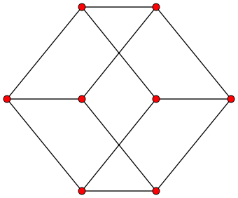
Weightless Neural Networks
Designing a good λ can be hard for complex objects
Individual properties quickly fill up the combinatorial space
How to add a Bird category to the current design?
Bird = (2, Feathers, Terrestrial)
(1, 1, 0)
(1, 1, 1) Insect
(0, 1, 0) | (Legs < 4, Chitinous, Aquatic)
(0, 1, 1) | (Legs < 4, Chitinous, Terrestrial)
(1, 0, 0) | (Legs > 4, Non-chitinous, Aquatic)
(1, 0, 1) | (Legs > 4, Non-chitinous, Terrestrial)
(1, 1, 0) | (Legs > 4, Chitinous, Aquatic)
(0, 1, 0)
(0, 1, 1)
(1, 0, 0)
(1, 0, 1)
Fish (0, 0, 0)
(0, 0, 1) Mammal
Notes:
A weightless neuron can approximate a function from a domain set X to an image set Y as long as a good definition for the function “lambda” can be given. “Good” here means that “different” elements from X (however you define “different” in X) are mapped to suitably distant bit strings.
Unfortunately, such good definitions for “lambda” are very hard to come by for complex objects. The problem is that as bit positions are allotted to represent specific properties, a corresponding meaning is automatically assigned to all bit strings, and we quickly run off combinatorial “space” to fill with extra cases.
For example, this is the space of all bit strings of length 3. These are the strings for which we assigned some category already, and these are the “free” bit strings. Under the current mapping from X to bit strings of length 3, how could we add a Bird category to the system?
The answer is that we can't. All those “free” bit strings already have some meaning assigned to them, in terms of the properties of set X, and none of them match our description of the Bird category.
Of course in this case we could enlarge the bit strings to 4 or 5, assign an extra bit to the number of legs or the body cover – but where will it end, if we have to add a couple extra bits every time we add a new category to the training set? What about applications where the category set is unbounded, such as face recognition? Is there any way to increase the number of categories a weightless neuron can recognize, without increasing the length of bit strings each time?

Slide 12
Weightless Neural Networks
Instead of one weightless neuron, use a neuron network
Break down image set elements into features
Relate domain feature sets to image feature sets
Assign related feature sets to separate neurons
Reassemble image set elements out of feature responses
Notes:
For a single neuron, the answer is “no”. But we can get around this limitation by working with several neurons, creating a so-called weightless neuron network.
The basic idea is that instead of a single neuron trying to model a function between two complex objects, we first break those objects down into their constituent features, and have different neurons approximate functions between pairs of features.
One consequence of this approach is that when querying the network, we don't get a complete object anymore, but only a set of separate features. It's necessary then to devise some way to reconstruct image set elements out of these constituent parts.

Slide 13
Weightless Neural Networks
Break down image set elements into features
Y = {yi = (Name)}
Mammal
Bird
Fish
Insect
G = {gi = (Clade, Flight, Breathes)}
Vertebrate | No | Air
Vertebrate | Yes | Air
Vertebrate | No | Water
Invertebrate | Yes | Air
Notes:
Back to our animal classifier, we can start by breaking down the animal categories into their characteristic features.
So Mammals are vertebrate, non-flying, air-breathing animals;
Birds are vertebrate, flying, and air-breathing;
Fishes are vertebrate, non-flying and water-breathing;
And insects are invertebrate, flying and air-breathing.
In time, I know there are flying mammals, air-breathing fishes and so on, but let's gloss over these details of biology and concentrate on the machine learning aspect.

Slide 14
Weightless Neural Networks
Relate domain feature sets to image feature sets
X = {xi = (Legs, Cover, Habitat)}
4 | Hair | Ground
2 | Feathers | Ground
0 | Scales | Water
6 | Chitin | Ground
X¹ = {x¹i = (Legs)} | O¹ = {o¹i = (Clade)}
0 | Vertebrate
2 | Vertebrate
4 | Vertebrate
6 | Invertebrate
X² = (x²i = (Cover)) | O² = {o²i = (Flight)}
Hair | No
Feathers | Yes
Scales | No
Chitin | Yes
X³ = (x³i = (Habitat)) | O³ = {o³i = (Breathes)}
Ground | Air
Water | Water
Notes:
Clearly specific image set features are more closely related to some domain set features than others.
So it is that there are no healthy vertebrates of more than four legs, so if an animal has six or more of them, it's safe to classify them as vertebrate.
Likewise, more often than not feathered and chitinous animals can fly, whereas animals with other kinds of body cover cannot.
And finally, very few animals who breathe water ever manage to live outside it.
Now instead of a single training set, we have three.

Slide 15
Weightless Neural Networks
Assign related feature sets to separate neurons
(1, 1, 1) Invertebrate
n1 : λ1(X¹) → O¹
(0, 1, 0)
Vertebrate
Vertebrate (0, 0, 0)
(0, 0, 1) Vertebrate
Notes:
Likewise we can have three neurons trained on them, each with its own “lambda” function.
For the first training set, relating number of legs to clade, we design a “lambda” function that keeps the leg sets of vertebrates close together, and the invertebrate set further distant.

Slide 16
Weightless Neural Networks
Assign related feature sets to separate neurons
(1, 1, 1) Yes
n2 : λ2(X²) → O²
(0, 1, 0)
No
Yes (0, 0, 0)
(0, 0, 1) Yes
Notes:
For the second training set, relating body cover to flight ability, we have the chitinous cover be represented by a bit string most distant from the other three categories, since animals covered in chitin are generally very different from those covered in hair, feathers and scales.

Slide 17
Weightless Neural Networks
Assign related feature sets to separate neurons
(1, 1, 1) Water
n3 : λ3(X³) → O³
Air (0, 0, 0)
Notes:
Finally, for the third training set, relating breathing ability to habitat, there are only two categories, so we place them as further apart as can be.

Slide 18
Weightless Neural Networks
Reassemble image set elements out of feature responses
ω: G³ → Y
G = {gi = (Clade, Flight, Breathes)}
Vertebrate | No | Air
Vertebrate | Yes | Air
Vertebrate | No | Water
Invertebrate | Yes | Air
Y = {yi = (Name)}
Mammal
Bird
Fish
Insect
ω
Notes:
Clearly none of these neurons will return the answer we want, which is the animal's category. In order to obtain that answer we need some procedure to get to the animal category from the animal features they return. In this case we can simply do a reverse lookup on the features table, returning the corresponding category.

Slide 19
Weightless Neural Networks
W
2
(0, 0, 1)
n1
Vertebrate
Xz
2
Hair
Ground
λ1(x1)
ω
Hair
(0, 0, 0)
n2
No
Mammal
λ2(x2)
Ground
(0, 0, 0)
n3
Air
λ3(x3)
Notes:
So for our example weightless neural network of three neurons, if we want to find the category for an input description of an animal of two legs, who's covered in hair and lives on the ground, first we take each of these properties separately, convert them to bit strings using the corresponding “lambda” functions, and then query each neuron with the corresponding bit string.
The returned animal features are hen used to look up on the animal table, and the corresponding category is returned as the network's response.

Slide 20
Weightless Neural Networks
A weightless neural network is defined in terms of:
  A set of neurons W
  A domain set decomposition function α
  An image set decomposition function β
  A bit string construction function λ
  An assignment function γ
  A reassembly function ω
Notes:
Generalizing on this example, we can define the architecture of a weightless neural network in terms of:

Slide 21
Weightless Neural Networks
xk
fk,1
bk,1
γ
W
α
fk,2
λ
bk,2
( , )
...
...
bk,1
gk,1
na
fk,m
bk,m
( , )
bk,2
gk,2
nb
yk
gk,1
...
...
β
gk,2
( , )
...
bk,m
gk,m
nz
gk,m
Notes:
Schematically, if I have a neuron network W and an input X and an output Y I want to teach the network, first I have to break X down into a list of features, and convert each feature to a bit string. Then I decompose Y into its constituent features, and pair up the bit strings and output features. These are then sent to the network's neurons for training.
The functions alpha, beta and gamma that perform these breaking and assigning operations are parameters of the network. They must be provided by the network designer, and are problem-dependent – there is no universal definition, for each problem we must try and come up with a custom set of functions.

Slide 22
Weightless Neural Networks
W
bk,1
na
gk,1
xk
fk,1
bk,1
γ
ω
yk
α
fk,2
λ
bk,2
bk,2
nb
gk,2
...
...
fk,m
bk,m
...
...
...
bk,m
nz
gk,m
Notes:
Similarly, when recovering information from the network, an input X must be broken down into features, which are converted to bit strings that are assigned to neurons for querying. The features returned by these neurons are then gathered by the assembling function omega, which comes up with an object from the image set from them. Again the definition of omega depends on the problem, and must be figured by the network designer.

Slide 23
Weightless Neural Networks
What problems are WNN's best suited to?
Complex objects
Available training set
Unknown / unavailable analytical solution
Some things are known on the structure of the problem:
  How to break domain and image elements down to features
  Which domain features best predict which image features
  How to measure the “distance” between domain features
  How to construct an image element from a feature set
Architecture is designed / understood by humans
Notes:
So what problems are weightless neural networks good at?
As a rule of thumb, if the problem involves elements of complex internal structure, and you have a good general idea on how the pieces within this structure relate to each other – but not enough to come up with an analytic solution – then weightless neural networks might prove a good match.
Specifically you ought to know the following things about your problem:
How to break domain and image elements down to features
Which domain features best predict which image features
How to measure the “distance” between domain features
How to construct an image element from a feature set
One appeal of weightless neural networks over, say, multilayer perceptron networks is that, since the network's architecture is designed by a human based on problem domain knowledge, it's relatively easy to know or at least speculate how it comes up with the answers it gives. In contrast, it's very hard to deduce how a perceptron network comes up with its responses.

Slide 24
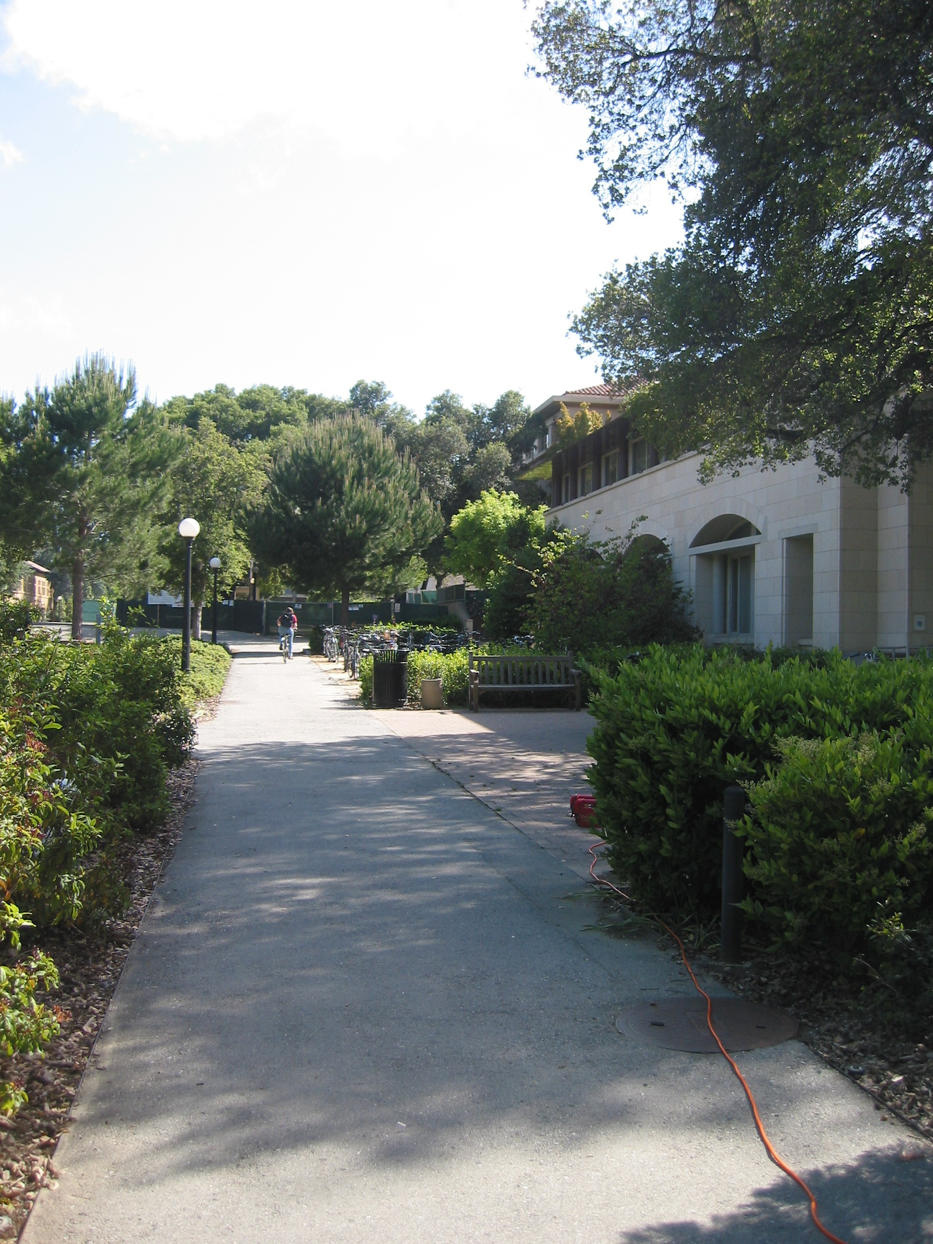
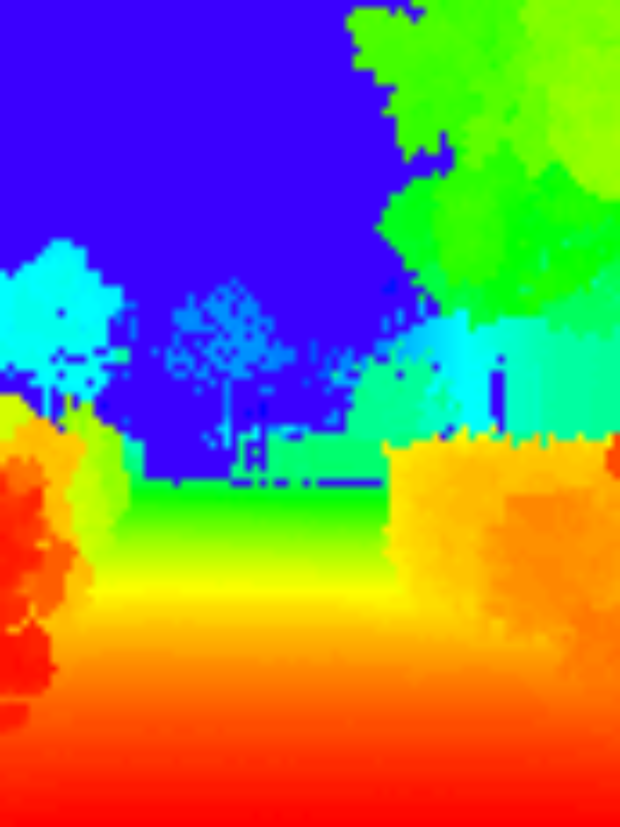
Depth Map Estimation
Deriving the distances from the viewer to points in a scene
Directly via measuring device (e.g. laser range scanner)
Indirectly via inference system (e.g. stereo vision rig)
S

Slide 25
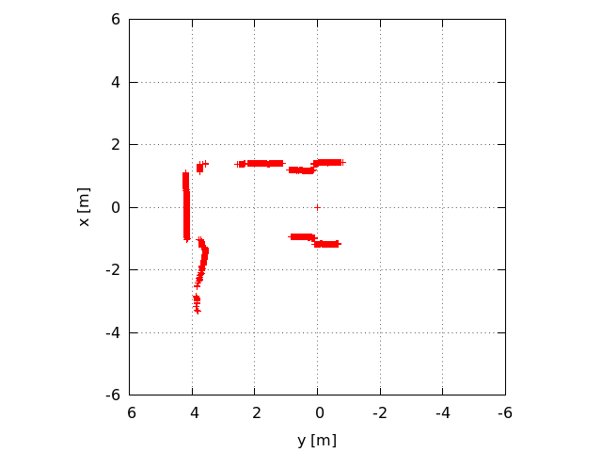
Depth Map Estimation
Laser range scanners are often limited to a single horizontal or vertical band (1D)

Slide 26
Depth Map Estimation
Stereo correspondence systems explore disparities between images apprehended by each camera
O
a1
a2
C1 C2

Slide 27
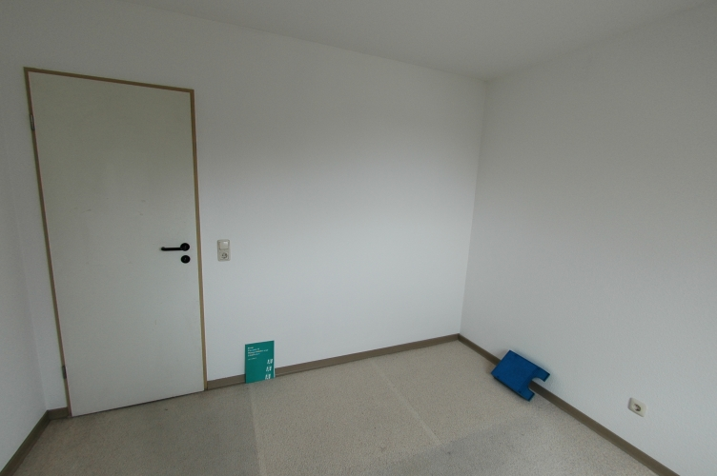
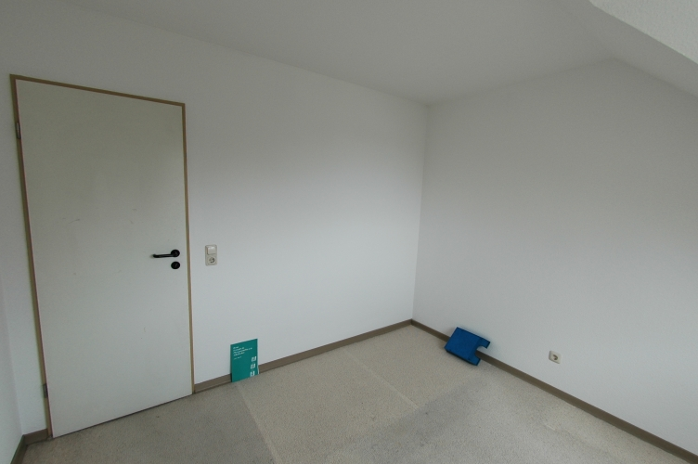
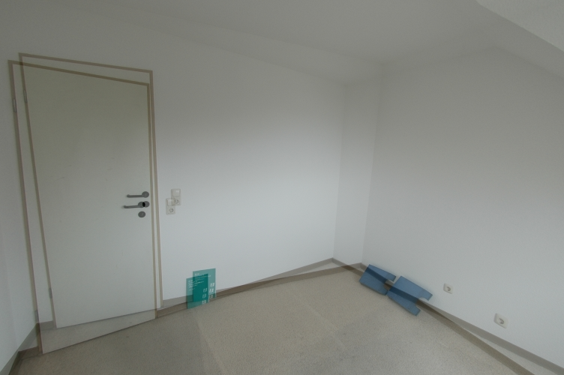
Depth Map Estimation
This tends to work poorly for featureless regions

Slide 28
Depth Map Estimation
Monocular depth estimation can complement stereo correspondence systems, or be used on their own
Learning-based approach
  Markov Random Fields (MRF)
  Weightless Neural Networks
Construction of a training set
  Separate depth acquisition system (e.g. movable laser scanner)
  After system is trained, simpler platform can be used

Slide 29
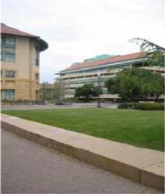
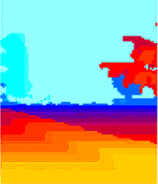
Depth Map Estimation
Training set
System
Training
...

Slide 30
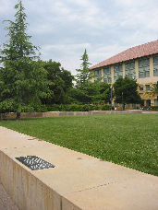
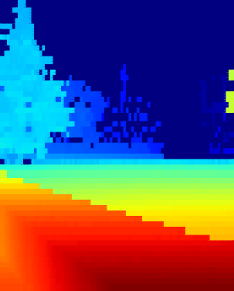
Depth Map Estimation
System
Test
Estimate

Slide 31
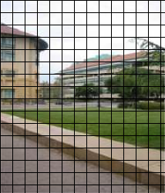
Depth Map Estimation
During training, images are divided in patches

Slide 32
Depth Map Estimation
A depth value is assigned to each patch
( , d1)
...
( , dk)
...
( , dn)

Slide 33
Depth Map Estimation
Pairs are assigned to neurons in the network for training
W
( , d1)
...
( , dk)
...
( , dn)
n1
...
ni
...
nz

Slide 34
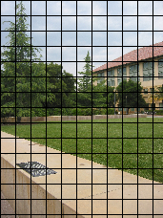
Depth Map Estimation
During testing, images are again divided in patches
Patches are dispatched to neurons, which return the closest associated depth values
Depths are collected and used to assemble a depth map
W
n1
ni
nz

Slide 35

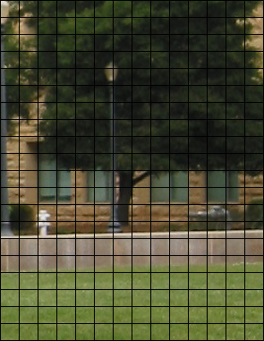
Visual Representations for WNN's
Each pixel in an RGB image takes 24 bits
A patch of 19x21 pixels contains 9576 bits

Slide 36
Visual Representations for WNN's
Sampling can be used to avoid the curse of dimensionality
How the human visual system processes images?
  Cones sense different color ranges
  Rods sense light intensity
  Photo-receptors concentrate in the fovea
  Neurons record differences between a receptor and its neighbors, not absolute values

Slide 37
Visual Representations for WNN's
HSL color space
  H, S channels: color information
  L channel: brightness
H
S
L

Slide 38
Visual Representations for WNN's
Sampling by n synapses {s1, s2, … , sk, … , sn}
Synapses distributed in a Gaussian pattern
Synapses chosen randomly at startup time

Slide 39
Visual Representations for WNN's
Recording differences
  Add an edge map to the list of projections
H
S
L
Edges

Slide 40
Visual Representations for WNN's
Recording differences
  Add an edge map to the list of projections
  Use minchinton cells to convert synapse outputs to single bits
A minchinton cell is formed by a pair of synapses (sk, sk+1)
Returns 1 if value(sk) > value(sk+1), and 0 otherwise

Slide 41
Visual Representations for WNN's
The diagram below summarizes the resulting architecture:
Patch
Projections
H
S
L
Edges
Synapses
Minchinton cells
>
>
>
>
>
>
>
>
>
>
>
>
>
>
>
>
b
b
b
b
b
b
b
b
b
b
b
b
b
b
b
b
Input bit string

Slide 42
Visual Representations for WNN's
64 synapses per projection
256 synapses per patch
Bit string length r = 256

Slide 43
Visual Representations for WNN's
64 synapses per projection
256 synapses per patch
Bit string length r = 256

Slide 44
Visual Representations for WNN's
64 synapses per projection
256 synapses per patch
Bit string length r = 256

Slide 45
Visual Representations for WNN's
64 synapses per projection
256 synapses per patch
Bit string length r = 256

Slide 46
Visual Representations for WNN's
69d6a95dd54a52b2
d3485531c9a8a53b
B24cb351a751b051
56e2506978b4554d
51af36758a8ed9a9
9c268184cf356553
Bca0db92a76ca205
4557566eb8462d96
19x21 pixels
9576 bits
256 bits

Slide 47

Network Architecture
Depth bands are often present in depth maps
Lower bands mostly contain lower depth values
Higher bands mostly contain higher depth values

Slide 48

Network Architecture
Different neurons are assigned to specific bands
N1
N2
N3
N4
N5
N6

Slide 49
Network Architecture
Each band is sampled by several neurons
Each neuron has its own unique synaptic layout
N1,1
N1,2
N1,3
N1,4
N2,1
N2,2
N2,3
N2,4
N3,1
N3,2
N3,3
N3,4
N4,1
N4,2
N4,3
N4,4
N5,1
N5,2
N5,3
N5,4
N6,1
N6,2
N6,3
N6,4

Slide 50
Network Architecture
During training, each (patch, depth) pair is dispatched to all neurons assigned to the horizontal band where it is located
N1,1
N1,2
N1,3
N1,4
N2,1
N2,2
N2,3
N2,4
N3,1
N3,2
N3,3
N3,4
N4,1
N4,2
N4,3
N4,4
N5,1
N5,2
N5,3
N5,4
N6,1
N6,2
N6,3
N6,4

Slide 51
Network Architecture
During training, each (patch, depth) pair is dispatched to all neurons assigned to the horizontal band where it is located
N1,1
N1,2
N1,3
N1,4
N2,1
N2,2
N2,3
N2,4
N3,1
N3,2
N3,3
N3,4
N4,1
N4,2
N4,3
N4,4
N5,1
N5,2
N5,3
N5,4
N6,1
N6,2
N6,3
N6,4

Slide 52
Network Architecture
During training, each (patch, depth) pair is dispatched to all neurons assigned to the horizontal band where it is located
N1,1
N1,2
N1,3
N1,4
N2,1
N2,2
N2,3
N2,4
N3,1
N3,2
N3,3
N3,4
N4,1
N4,2
N4,3
N4,4
N5,1
N5,2
N5,3
N5,4
N6,1
N6,2
N6,3
N6,4

Slide 53
Network Architecture
During training, each (patch, depth) pair is dispatched to all neurons assigned to the horizontal band where it is located
N1,1
N1,2
N1,3
N1,4
N2,1
N2,2
N2,3
N2,4
N3,1
N3,2
N3,3
N3,4
N4,1
N4,2
N4,3
N4,4
N5,1
N5,2
N5,3
N5,4
N6,1
N6,2
N6,3
N6,4

Slide 54
Network Architecture
During training, each (patch, depth) pair is dispatched to all neurons assigned to the horizontal band where it is located
N1,1
N1,2
N1,3
N1,4
N2,1
N2,2
N2,3
N2,4
N3,1
N3,2
N3,3
N3,4
N4,1
N4,2
N4,3
N4,4
N5,1
N5,2
N5,3
N5,4
N6,1
N6,2
N6,3
N6,4

Slide 55
Network Architecture
During training, each (patch, depth) pair is dispatched to all neurons assigned to the horizontal band where it is located
N1,1
N1,2
N1,3
N1,4
N2,1
N2,2
N2,3
N2,4
N3,1
N3,2
N3,3
N3,4
N4,1
N4,2
N4,3
N4,4
N5,1
N5,2
N5,3
N5,4
N6,1
N6,2
N6,3
N6,4

Slide 56
Network Architecture
During training, each (patch, depth) pair is dispatched to all neurons assigned to the horizontal band where it is located
N1,1
N1,2
N1,3
N1,4
N2,1
N2,2
N2,3
N2,4
N3,1
N3,2
N3,3
N3,4
N4,1
N4,2
N4,3
N4,4
N5,1
N5,2
N5,3
N5,4
N6,1
N6,2
N6,3
N6,4

Slide 57
Network Architecture
During testing, the m neurons on each band will output m estimates for each image patch; the value more often returned will be taken as the final estimate for the patch
N1,1
N1,2
N1,3
N1,4
d1
d2
d3
d4
dx
N2,1
N2,2
N2,3
N2,4
N3,1
N3,2
N3,3
N3,4
N4,1
N4,2
N4,3
N4,4
N5,1
N5,2
N5,3
N5,4
N6,1
N6,2
N6,3
N6,4

Slide 58
Network Architecture
During testing, the m neurons on each band will output m estimates for each image patch; the value more often returned will be taken as the final estimate for the patch
N1,1
N1,2
N1,3
N1,4
d1
d2
d3
d4
dy
N2,1
N2,2
N2,3
N2,4
N3,1
N3,2
N3,3
N3,4
N4,1
N4,2
N4,3
N4,4
N5,1
N5,2
N5,3
N5,4
N6,1
N6,2
N6,3
N6,4

Slide 59
Network Architecture
During testing, the m neurons on each band will output m estimates for each image patch; the value more often returned will be taken as the final estimate for the patch
N1,1
N1,2
N1,3
N1,4
N2,1
N2,2
N2,3
N2,4
d1
d2
d3
d4
dz
N3,1
N3,2
N3,3
N3,4
N4,1
N4,2
N4,3
N4,4
N5,1
N5,2
N5,3
N5,4
N6,1
N6,2
N6,3
N6,4

Slide 60
Results
Optimal system parameters:
  Neurons: 10 per band
  Synapses: 256 per neuron, gaussian distribution with σ = 40
Training set:
  Set: 425 (image, depth map) pairs, indoors and outdoors
  Dimensions: images 1704x2272, depth maps 86x107
  Patch dimensions: 19x21
  Training set: 190 pairs (44%)
  Validation set: 94 pairs (22%)
  Test set: 141 pairs (33%)

Slide 61
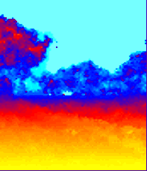
Results
Performance encouraging (indoors & outdoors) but limited
Estimation of a scene's general outlook is reliable
But finer details (and close objects by the middle of the image) are often missed
Training is fast, but testing is too slow, taking as much as 10min for a single scene

Slide 62
Doctoral Research
Autonomous environment discovery & recognition
Learning stage
  Identify prospective landmarks
  Separate landmark from background
  Record landmark appearance & robot's current position
Recalling stage
  Identify prospective landmarks
  Recall recorded landmark position
  Estimate robot's current position

Slide 63
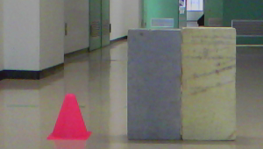
Doctoral Research
Landmark prospector
Sample database
“cone”
“cone”
(s1, s2, … , sn)
“door”
(s1, s2, … , sn)
...
WNN
Sample set for landmark “cone”
(i1, j1)
(x1, y1, z1)
(i2, j2)
(x2, y2, z2)
“Different” object
(possible landmark)
...
Interpolator
(e.g. linear, spline, etc)
(i', j')
(apparent position
of landmark in image)
(x', y', z')

Slide 64
The End
Questions?

